Slide 1
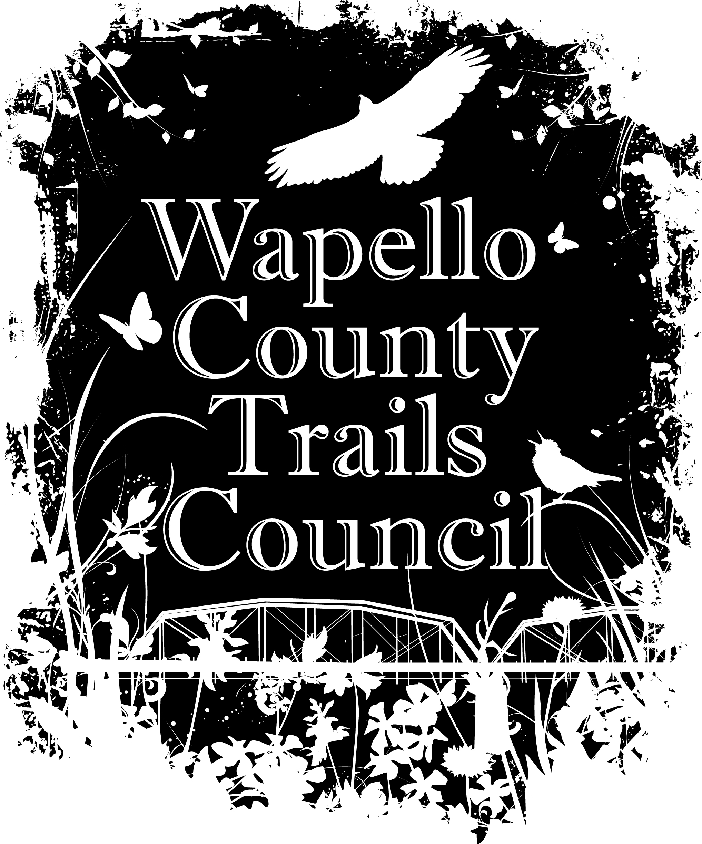
Formed in 2006, the council is a non-profit community organization whose purpose is to create and coordinate a trail system that promotes health, recreation, and safety while maintaining the natural beauty of this historic area.

Slide 2
Presenters:
Fred Jenkins, Treasurer, Wapello County Trails Council
Tom Lazio, Mayor, City of Ottumwa
Steve Siegel, Supervisor, Wapello County
Brad Little, President, Ottumwa Regional Legacy Foundation
Larry Gawronski, Executive Director, Bridge View Center
Kim Hellige, President, Wapello County Trails Council

Slide 3
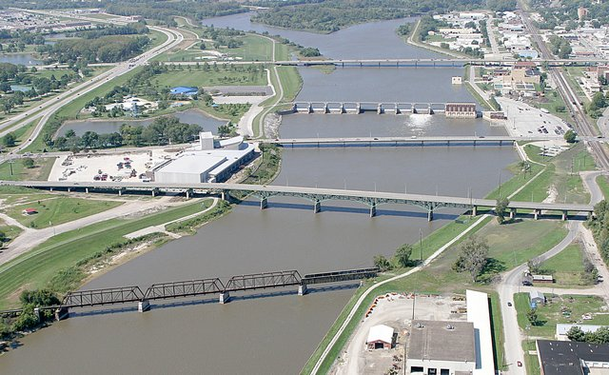
Ottumwa, City of Bridges

Slide 4
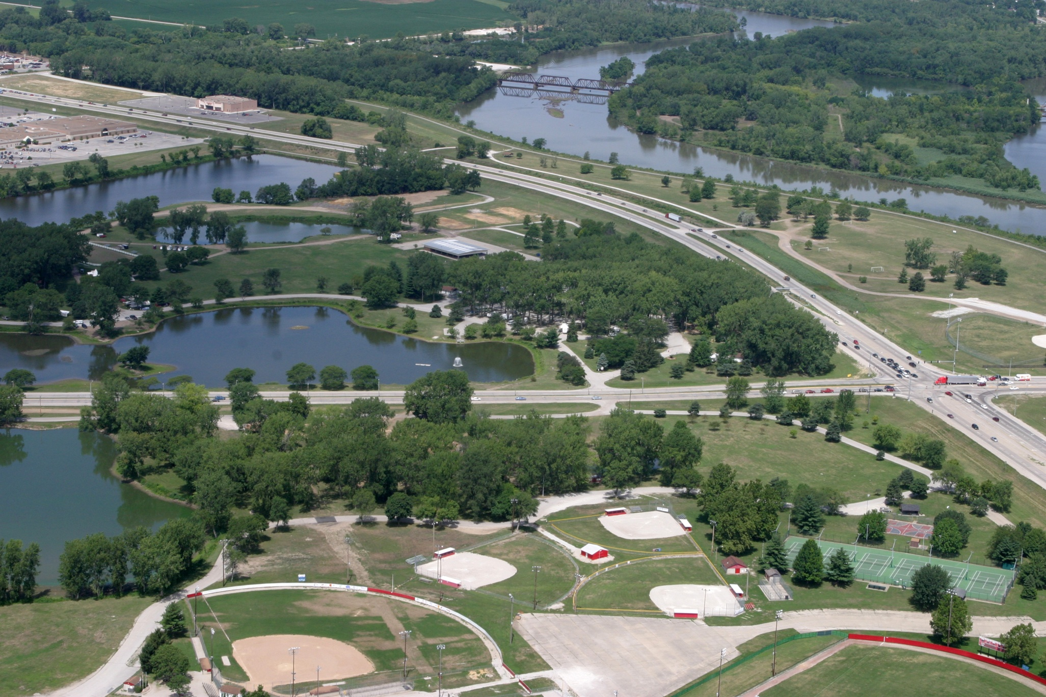
Location of Highway 34 Underpass in Ottumwa Park

Slide 5
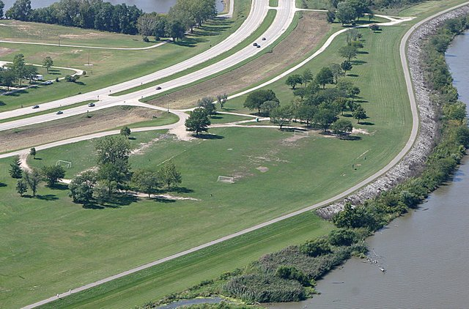
Aerial View of Highway 34 Underpass

Slide 7
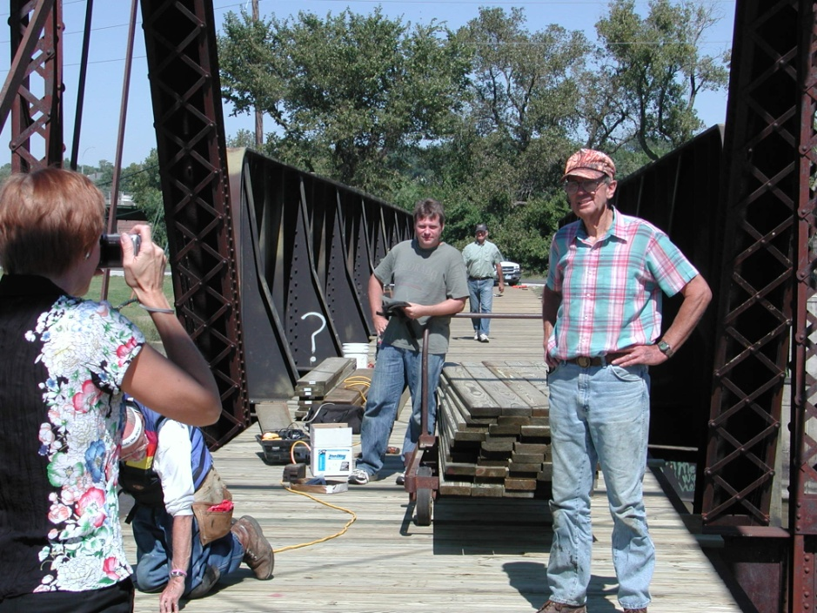
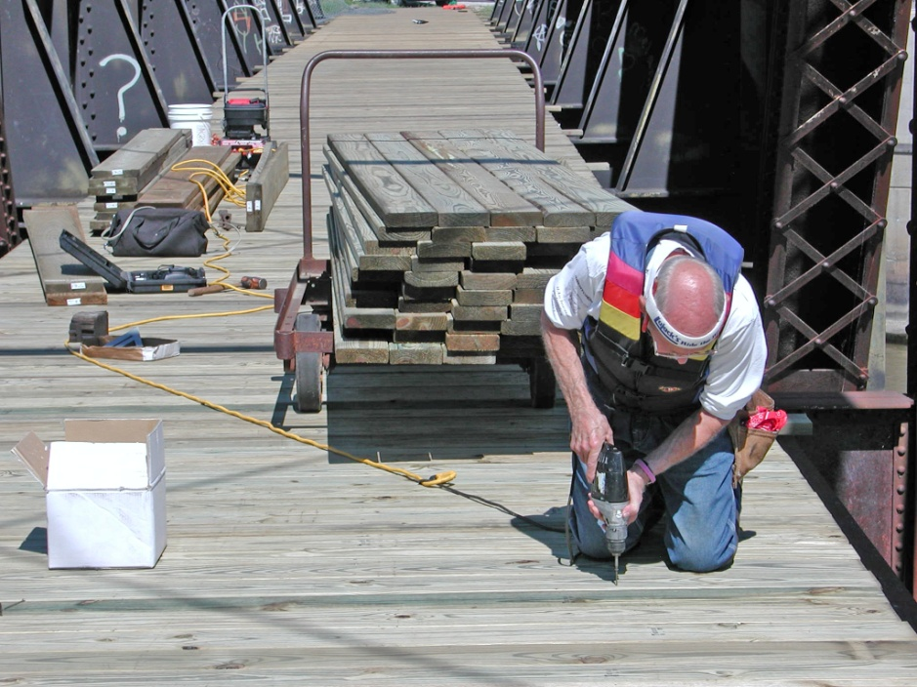
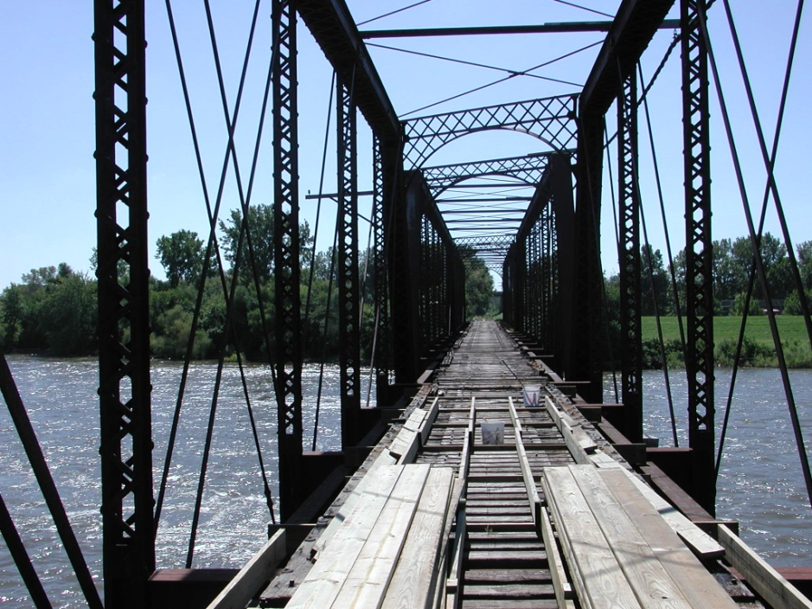
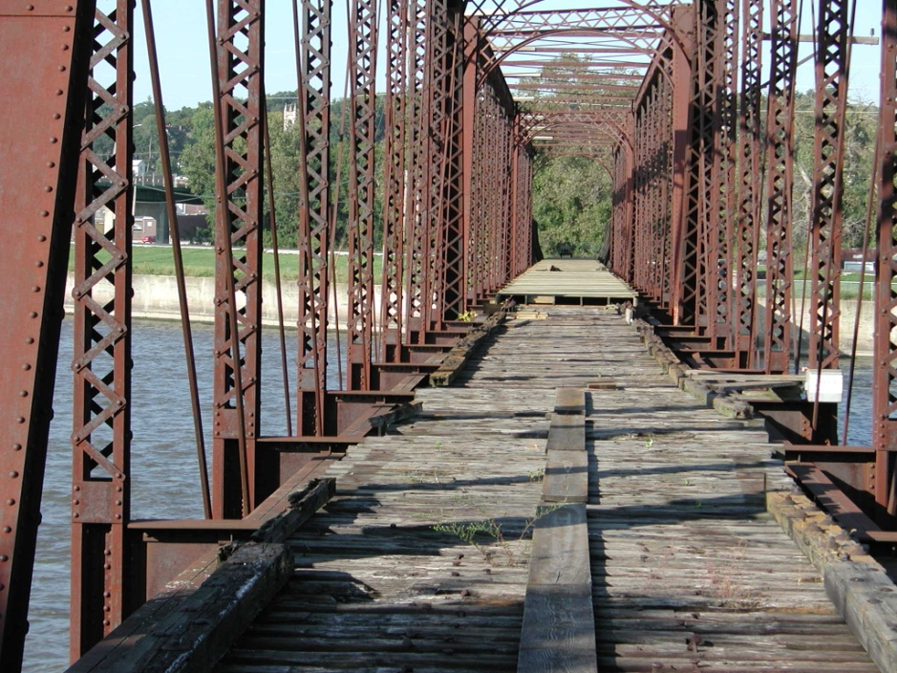
Wabash Trails Bridge – Connection Across River

Slide 8
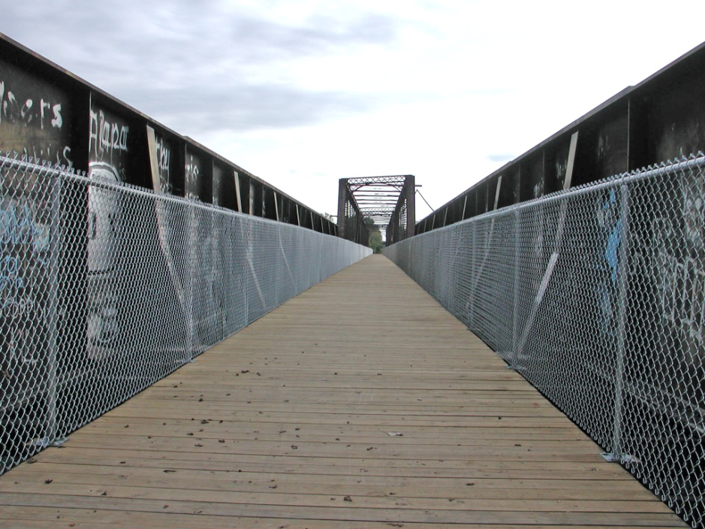
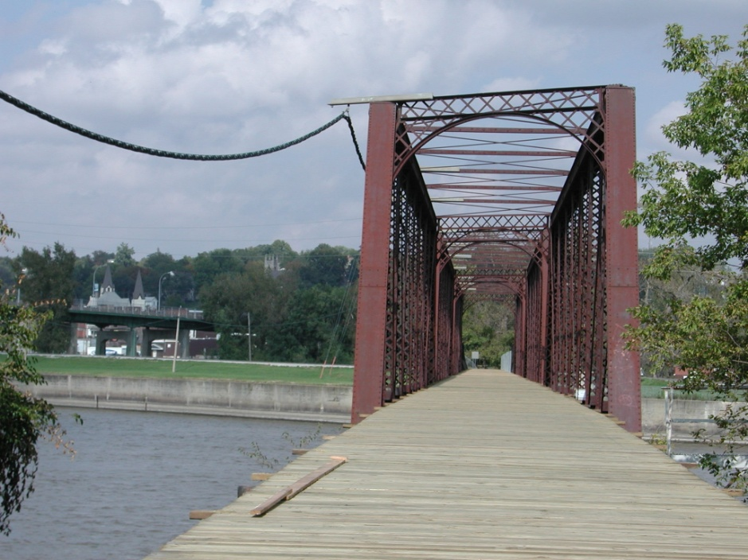
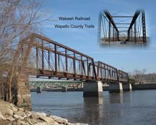
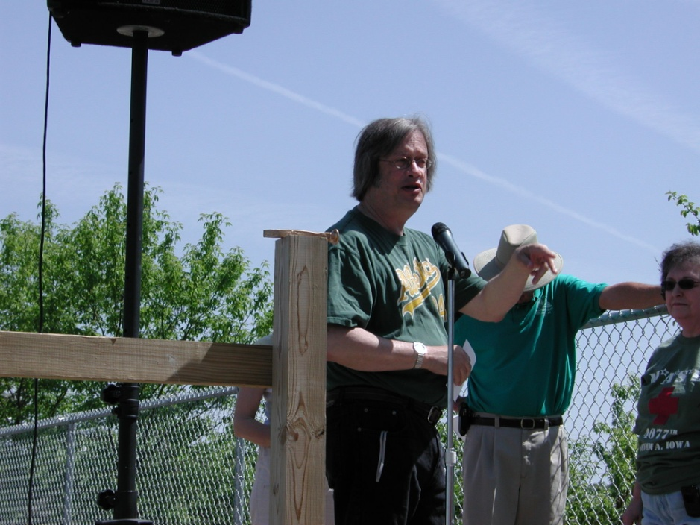

Slide 9
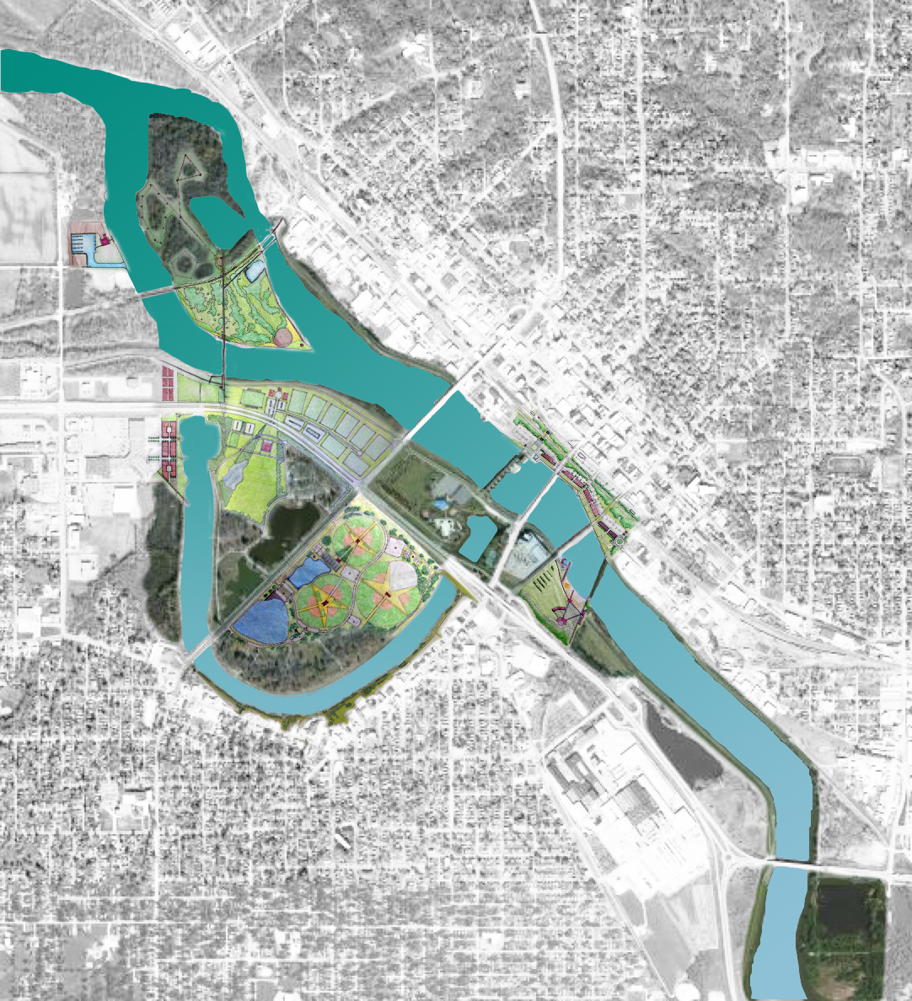
The Plan-in-Progress

Slide 10
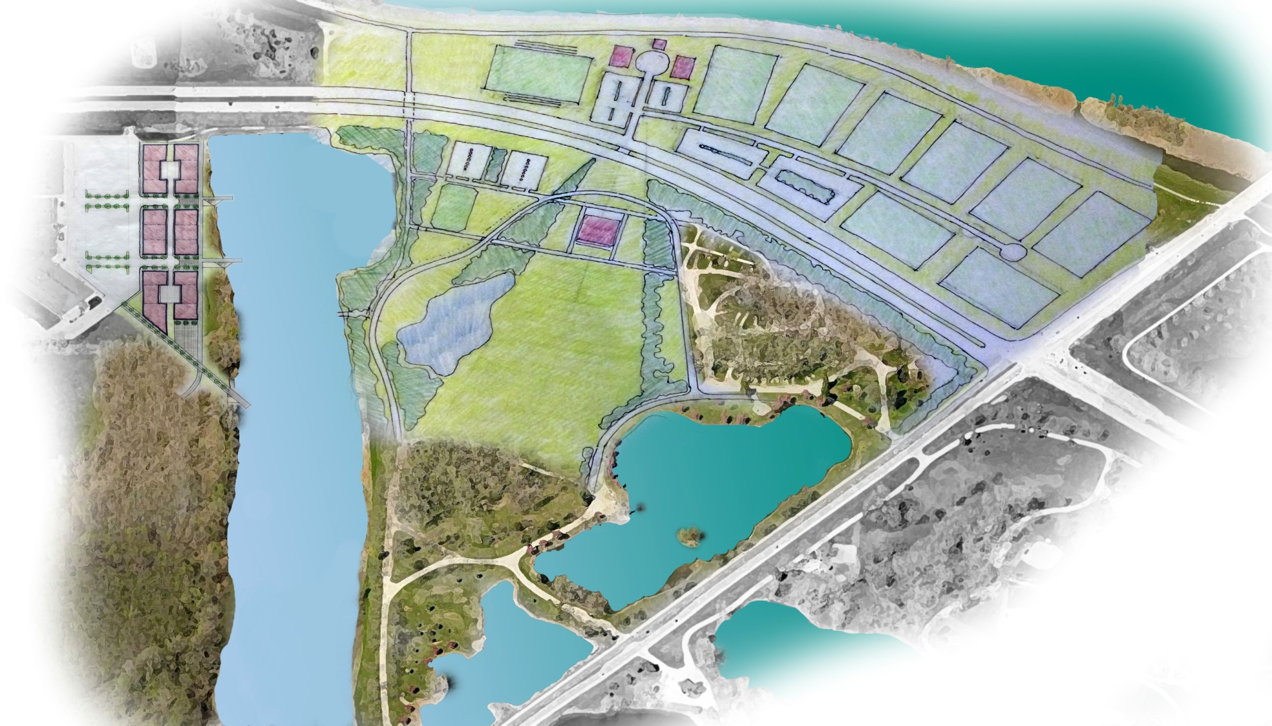
Greater Ottumwa Park

Slide 11
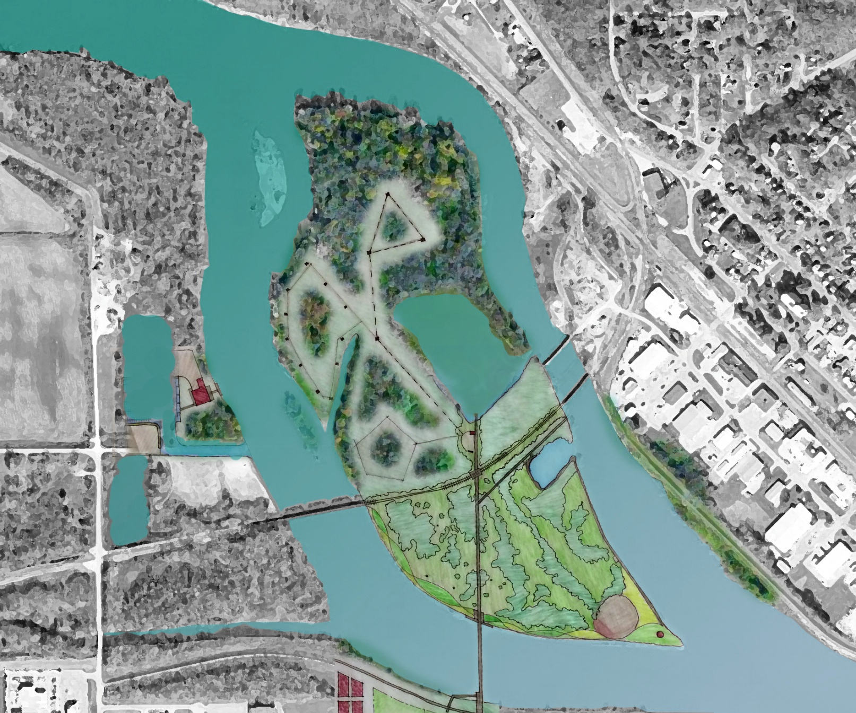
Turkey Island

Slide 13
Link to Current Riverfront
Renaissance
Expand
Recreational
Opportunities
Minimum
Maintenance
Link to Future
Events/Tourism
Safety
Feasibility
Quality of Life

Slide 15
Thank You !!
Wapello County Trails Council
City of Ottumwa
Wapello County
Ottumwa Regional
Legacy Foundation

